Slide 1
Introduction to Chef
Testing your automation code
Nathen Harvey - @nathenharvey
Wifi: surge2014 login: surge2014 password: surge2014

Slide 2
Prerequisites
Install Chef DK - downloads.getchef.com/chef-dk
Have an ssh client
Have a good text editor (Atom, Sublime, vim, emacs)
Git & GitHub Account (Optional)
http://bit.ly/1msreNZ

Slide 3
Introductions

Slide 4


Instructor
Nathen Harvey
Community Director, Chef
Co-host of the Food Fight Show
Co-organizer of DevOpsDC
5th year at Surge

Slide 5
Lab Assistants
Mark Harrison
Peter Burkholder
Karloff Rosario
YOU ☺

Slide 6
Hello!
System Administrator?
Developer?
DevOp?
Business Person?
Manager?

Slide 7
Hello!
Experience with configuration management?
Experience with Chef?

Slide 8
Course Objectives & Style

Slide 9
Course Objectives
After completing this course you will be able to:
Automate common infrastructure tasks with Chef
Describe Chef’s various tools
Apply Chef’s primitives to solve your problems
Verify your automation code BEFORE it runs in production

Slide 10
Learning Chef
You bring the domain expertise about your business and problems
Chef provides a framework for solving those problems
Our job is to work together to help you express solutions to your problems with Chef

Slide 11
Chef is a Language
Learning Chef is like learning the basics of a language
80% fluency reached quickly
20% just takes practice
The best way to LEARN Chef is to USE Chef

Slide 12
Training is a discussion
Lots of hands on labs
Lots of typing
Ask questions when they come to you
Ask for help when you need it
Help each other
We will troubleshoot and fix bugs on the spot

Slide 13
Just an Introduction
Today is just an Introduction to Chef
We’ll cover lots of topics but won’t go too deep on any of them
Any discussion that takes us too far off the path will be captured
We will return to these topics as time permits

Slide 14
Class Logistics
You are getting an early access preview of this course!
We’re going to try out some new things. There may be some rough edges
Follow along with the class on GitHub –
Github.com/nathenharvey/surge_introduction_to_chef

Slide 15
Class Logistics
Streaming LIVE to YouTube via Google+ Hangout
Slides in the GitHub repository
Code will be added to GitHub as we go
But…we have a social contract…
Notes:
The social contract includes:
No working ahead
Copy-n-paste only if typing didn’t work out properly for you
Be patient, courteous, etc.
Follow the code-of-conduct for the conference

Slide 16
Agenda

Slide 17
Agenda
Overview of Chef
Resources
Recipes
Cookbooks
Ensuring desired state
Infrastructure State
Faster Feedback with Testing
Wrap Up

Slide 18
Breaks!
We’ll take breaks when we need them
We will break for lunch, but lunch is not provided

Slide 19
Prerequisites
Install Chef DK - downloads.getchef.com/chef-dk
Have an ssh client
Have a good text editor (Atom, Sublime, vim, emacs)
Git & GitHub Account (Optional)

Slide 20
Slides, Code, Questions, etc.
github.com/nathenharvey/surge_introduction_to_chef
Slides are available now (subject to change)
Code will be added as we go
Submit PRs for any questions or topics that you’d like to see covered

Slide 21
Overview of Chef
Policy-based Infrastructure as Code

Slide 22

Benefits of Automation

Slide 23
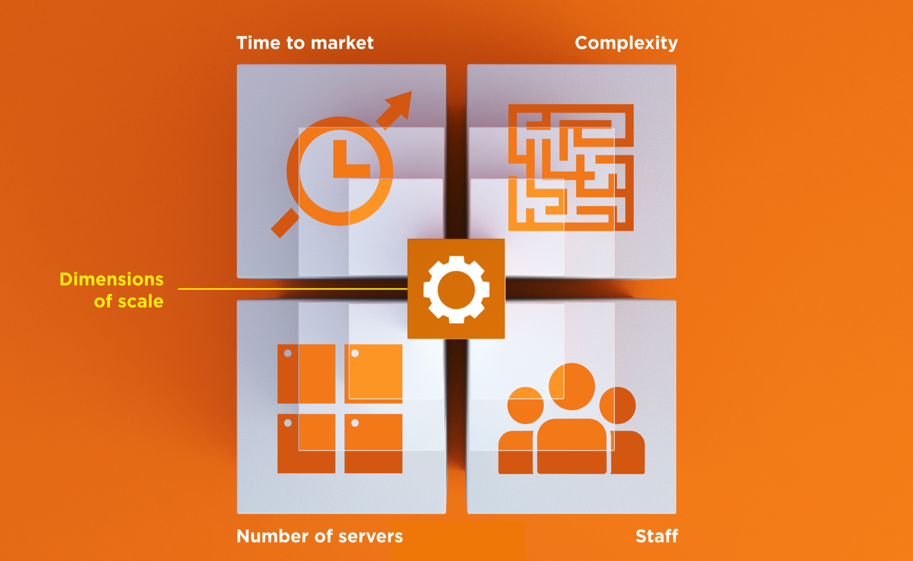
Dimensions of Scale

Slide 24
Automation Platform
Creates a dependable view of your entire network’s state.
Can handle complex dependencies among the nodes of your network.
Is fault tolerant.
Is secure.
Can handle multiple platforms
Can manage cloud resources
Provides a foundation for innovation

Slide 25
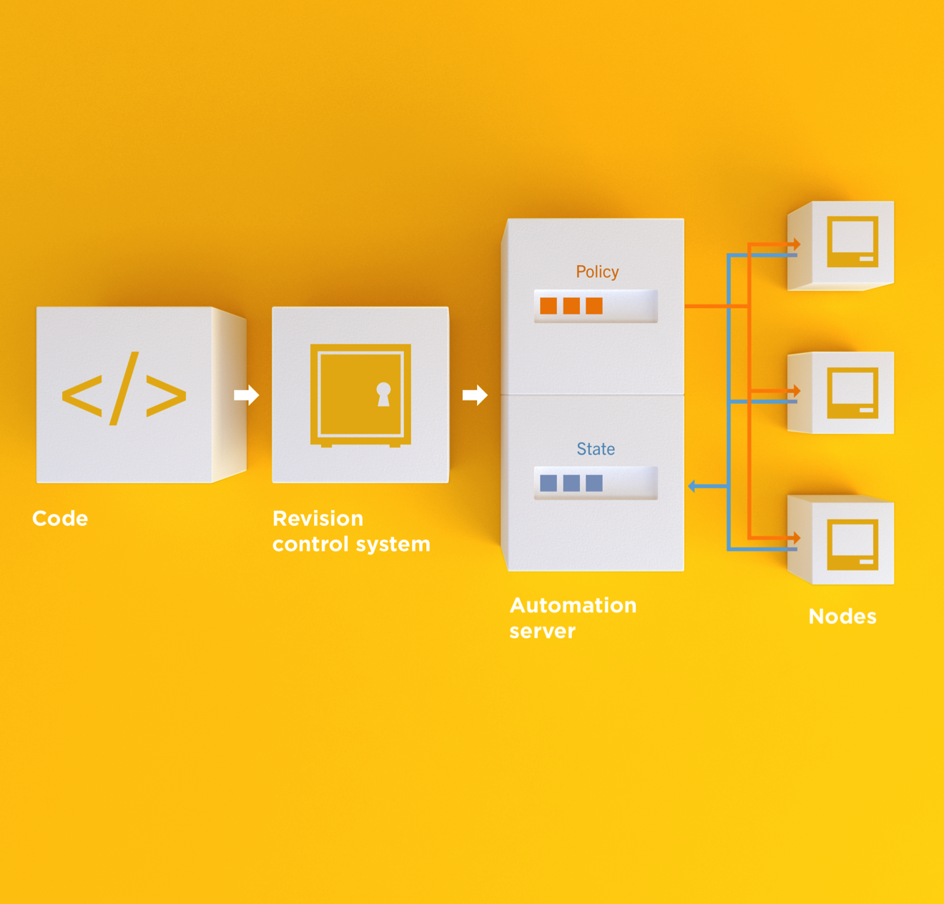
Infrastructure as Code
Programmatically provision and configure components
Notes:
Use the Chef framework and Chef programming language to define the components of your infrastructure. This allows you to capture and document the shape of your infrastructure in a consistent way.

Slide 26
Infrastructure as Code
Treat like any other code base
Notes:
Treat this like any other code base:
Store the code in a version control system.
Add automated tests to the code.
Refactor the code over time.
Build and version software artifacts (e.g. packages)
The code is executable documentation.
Store the code in a version control system.

Slide 27
Infrastructure as Code
Reconstruct business from code repository, data backup, and compute resources
Notes:
With your infrastructure now fully captured in code, you are now able to rebuild your entire business, well, at least all of your business’s applications, with your code repository, a backup of your data, and compute resources, be they bare metal, virtual machines, or cloud instances.

Slide 28
Infrastructure as Code
Programmatically provision and configure components
Treat like any other code base
Reconstruct business from code repository, data backup, and compute resources
Notes:
Stop for a minute and think about what we're saying here. Think about how freeing this can be. The next configuration change you need to make in production starts with a commit to your version control system. You can re-provision your infrastructure with another service provider; move from the data center to the clould and back again.How will this impact the way you run operations in your organization?What questions do you have?

Slide 29
Policy-based
You capture the policy for your infrastructure in code
Chef ensures each node in your infrastructure complies with the policy

Slide 30
Policy-based
Chef provides a domain-specific language (DSL) that allows you to specify policy for your infrastructure
Policy describes the desired state
Policies can be statically or dynamically defined
Notes:
Reduce complexity through abstraction
Store the code in version control (of course)
Static – the name of a package that should be installed
Dynamic – the hostname of the database server in the production environment

Slide 31
Resources
Fundamental building blocks

Slide 32
Resources
Piece of the system and its desired state
Package that should be installed
Service that should be running
File that should be generated
Cron job that should be configured
User that should be managed
And more
docs.getchef.com/chef/resources.html

Slide 33
Lab 1 – Install a text editor
Problem: Our workstation does not have $EDITOR installed
Success Criteria: You can edit files with $EDITOR
$EDITOR is your favorite command line text editor: vim, emacs, or nano

Slide 34
What’s up with the card?
http://bit.ly/1msreNZ
Login: chef
Password: sxypnerg

Slide 35
Login to your lab machine
ssh chef@54.164.75.30
The authenticity of host '54.165.227.226 (54.165.227.226)' can't be established.
RSA key fingerprint is c1:ec:ab:66:fb:22:4a:8f:c2:c5:9b:26:77:f3:dd:b3.
Are you sure you want to continue connecting (yes/no)? yes
Warning: Permanently added '54.165.227.226' (RSA) to the list of known hosts.
chef@54.165.227.226's password:

Slide 36
Welcome to your workstation
ChefDK version 0.2.2 is installed
chef --version
Chef user has passwordless sudo access
sudo cat /etc/shadow

Slide 37
Is $EDITOR installed?
which vim
/usr/bin/which: no vim in (/opt/chefdk/bin:/home/chef/.chefdk/gem/ruby/2.1.0/bin:/opt/chefdk/embedded/bin:/usr/local/bin:/bin:/usr/bin:/usr/local/sbin:/usr/sbin:/sbin:/home/chef/bin)

Slide 38
chef-apply
chef-apply is an executable program that allows you to work with resources
Is included as part of the ChefDK
A great way to explore resources
NOT how you’ll eventually use Chef in production

Slide 39
What does chef-apply do?
chef-apply --help
Usage: chef-apply [RECIPE_FILE] [-e RECIPE_TEXT] [-s]
--[no-]color Use colored output, defaults to enabled
-e, --execute RECIPE_TEXT Execute resources supplied in a string
-l, --log_level LEVEL Set the log level (debug, info, warn, error, fatal)
-s, --stdin Execute resources read from STDIN
-v, --version Show chef version
-W, --why-run Enable whyrun mode
-h, --help Show this message

Slide 40
Install vim
sudo chef-apply -e "package 'vim'"
Recipe: (chef-apply cookbook)::(chef-apply recipe)
* package[vim] action install
- install version 7.2.411-1.8.el6 of package vim-enhanced

Slide 41
Install emacs
sudo chef-apply -e "package 'emacs'"
Recipe: (chef-apply cookbook)::(chef-apply recipe)
* package[emacs] action install
- install version 23.1-25.el6 of package emacs

Slide 42
Install nano
sudo chef-apply -e "package 'nano'"
Recipe: (chef-apply cookbook)::(chef-apply recipe)
* package[nano] action install
- install version 2.0.9-7.el6 of package nano

Slide 43
Resources
Describe the desired state
Do not need to tell Chef how to get there
What happens if you re-run the chef-apply command?

Slide 44
Install $EDITOR again with chef-apply
sudo chef-apply -e "package 'vim'"
Recipe: (chef-apply cookbook)::(chef-apply recipe)
* package[vim] action install (up to date)

Slide 45
Resources – Test and Repair
Resources follow a test and repair model
Resource currently in the desired state? (test)
Yes – Do nothing
No – Bring the resource into the desired state (repair)

Slide 46
Recipes
Collection of resources

Slide 47
Lab 2 – Serve our homepage
Problem: We need a web server configured to serve up our home page
Success Criteria: We see our home page in a web browser

Slide 48
What is our desired state?
We see our home page in a web browser

Slide 49
What is required to meet this state?
What resources will we need?
Notes:
Web server installed (package)
Web server running (service)
Home page with HTML content (file)

Slide 50
Recipe
Collection of resources
Recipes can:
Install and configure software components
Manage files
Deploy applications
Execute other recipes
And more…

Slide 51
Create learnchef/lab2 directory
mkdir –p ~/learnchef/lab2

Slide 52
Move to the learnchef/lab2 directory
cd ~/learnchef/lab2

Slide 53
Is there a web server?
curl http://localhost
curl: (7) couldn't connect to host

Slide 54
Write a recipe for apache
~/learnchef/lab2/apache.rb
package "httpd"

Slide 55
Apply the apache recipe
sudo chef-apply apache.rb
Recipe: (chef-apply cookbook)::(chef-apply recipe)
* package[httpd] action install
- install version 2.2.15-31.el6.centos of package httpd

Slide 56
chef-apply a recipe
Now we are using chef-apply on a recipe, or a collection of resources
Success?

Slide 57
Is it working?
curl http://localhost
curl: (7) couldn't connect to host

Slide 58
Write a recipe for apache
~/learnchef/lab2/apache.rb
package "httpd"
service "httpd"

Slide 59
Apply the apache recipe
sudo chef-apply apache.rb
Recipe: (chef-apply cookbook)::(chef-apply recipe)
* package[httpd] action install (up to date)
* service[httpd] action nothing (up to date)

Slide 60
Is it working?
curl http://localhost
curl: (7) couldn't connect to host

Slide 61
Apply the apache recipe
sudo chef-apply apache.rb
Recipe: (chef-apply cookbook)::(chef-apply recipe)
* package[httpd] action install (up to date)
* service[httpd] action nothing (up to date)

Slide 62
Apply the apache recipe
sudo chef-apply apache.rb
Recipe: (chef-apply cookbook)::(chef-apply recipe)
* package[httpd] action install (up to date)
* service[httpd] action nothing (up to date)

Slide 63
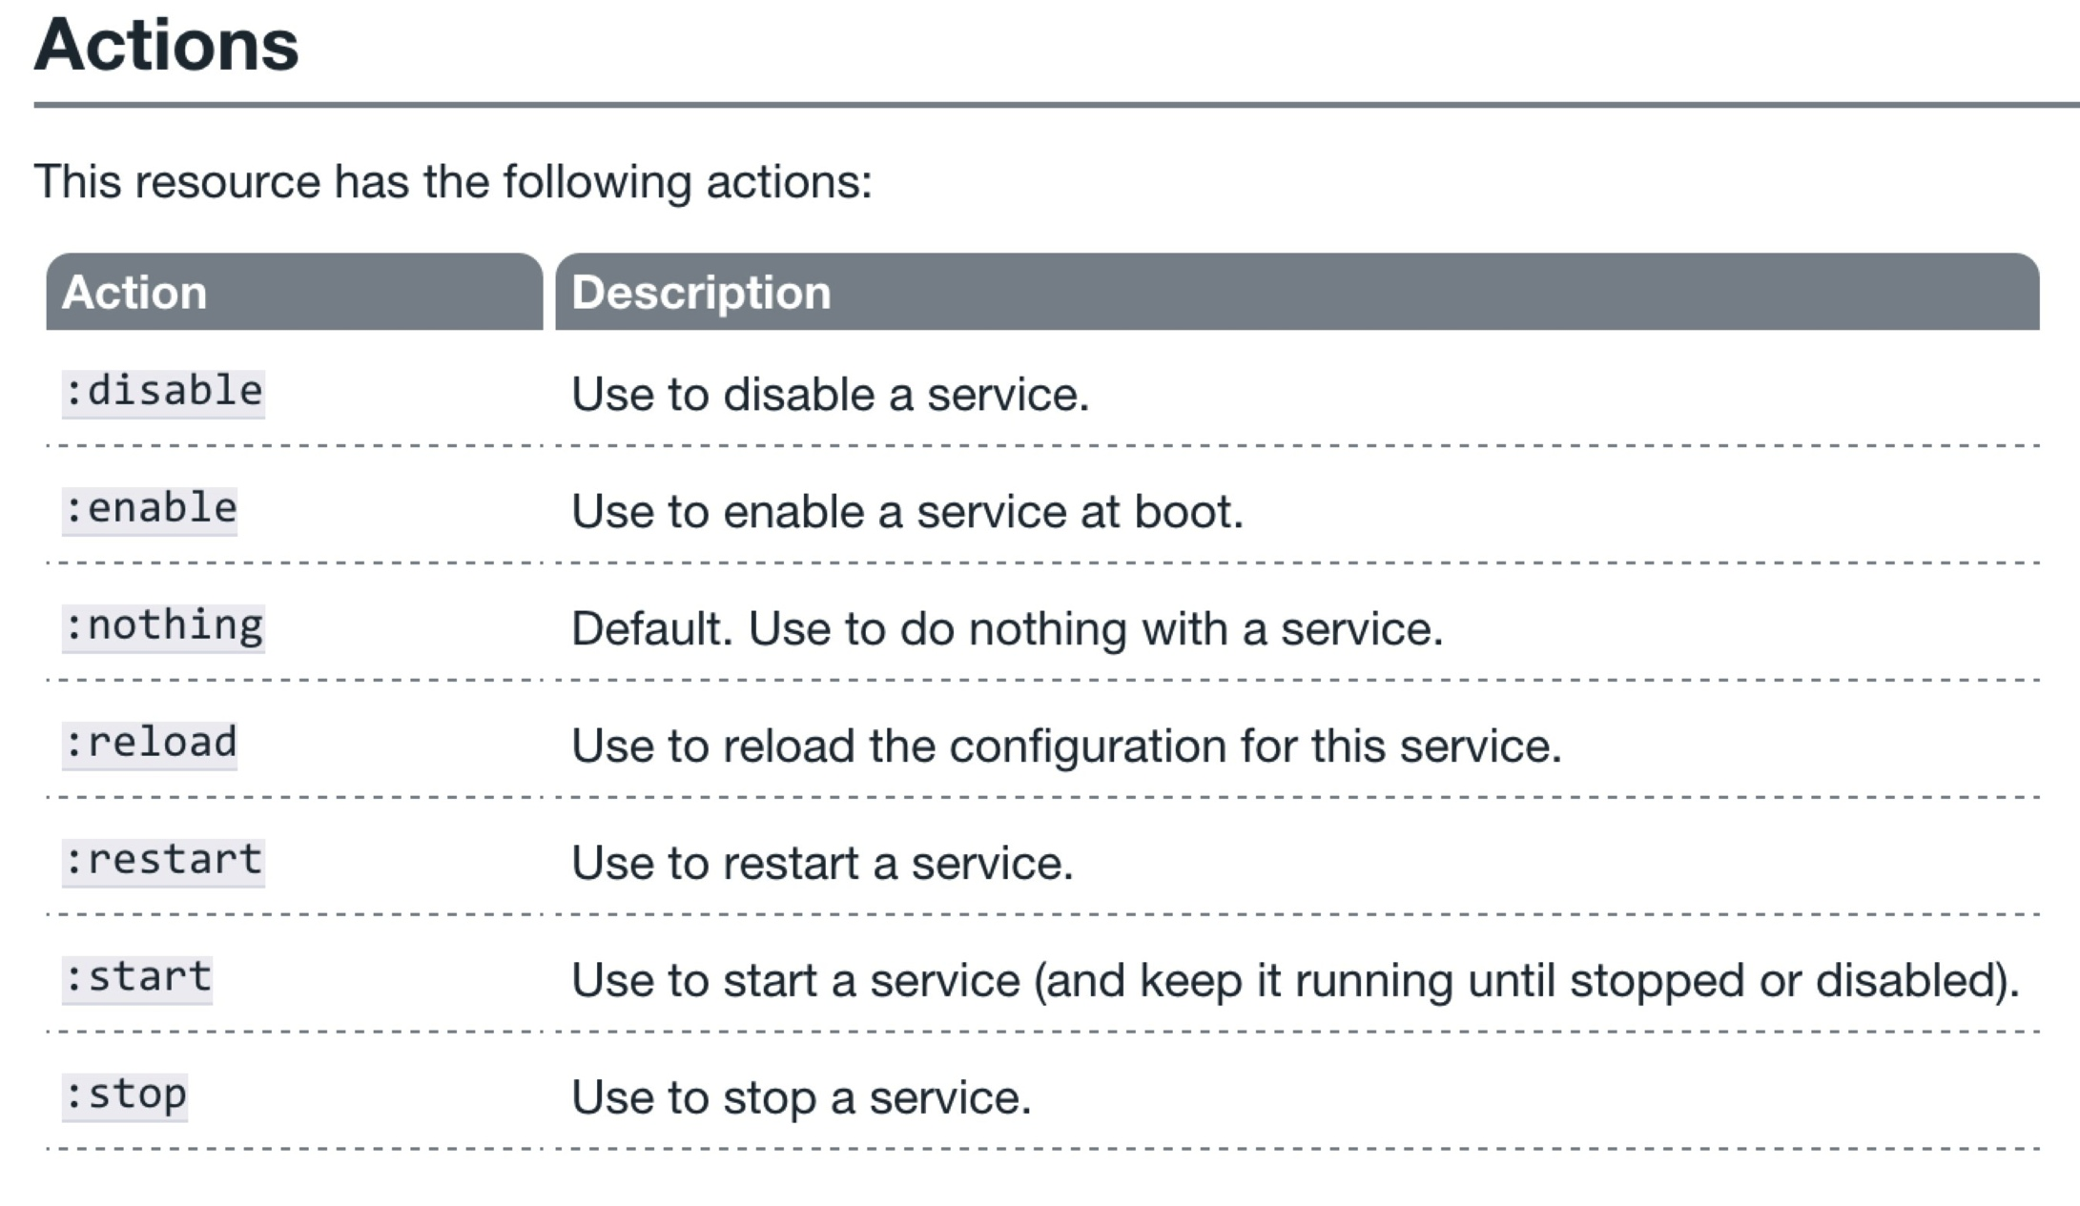
The service resource
http://docs.getchef.com/resource_service.html

Slide 64
Resources
Type (package, service, etc.)
Name (“httpd”, “vim”, etc.)
Actions
A description of the desired state of the resource
Defined as part of the resource
Will the action always be executed?

Slide 65
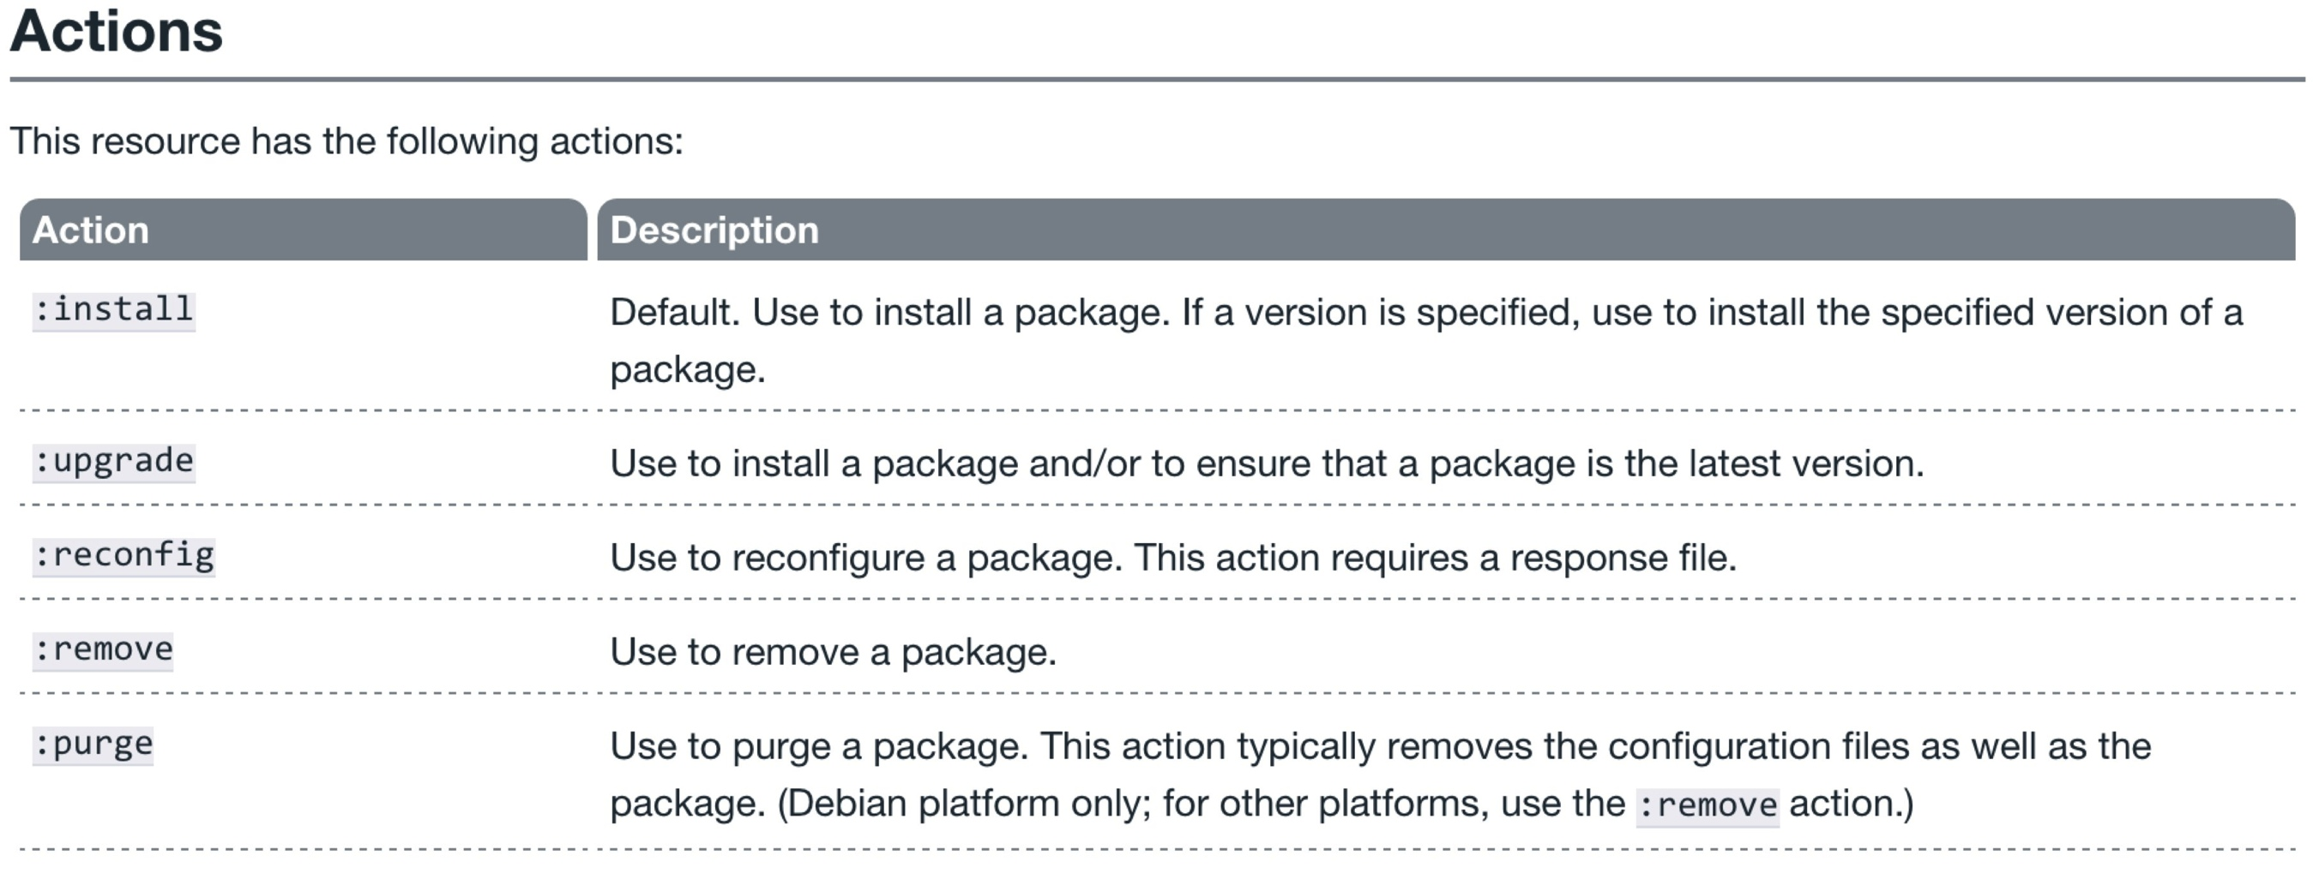
Why did the package resource work?
http://docs.getchef.com/resource_package.html

Slide 66
Why did the package resource work?
http://docs.getchef.com/resource_package.html

Slide 67
Write a recipe for apache
~/learnchef/apache.rb
package "httpd"
service "httpd" do
action :start
end

Slide 68
Apply the apache recipe
sudo chef-apply apache.rb
Recipe: (chef-apply cookbook)::(chef-apply recipe)
* package[httpd] action install (up to date)
* service[httpd] action start
- start service service[httpd]

Slide 69
Is it working?
curl http://localhost
<title>Apache HTTP Server Test Page powered by CentOS</title>
<meta http-equiv="Content-Type" content="text/html; charset=UTF-8" />
<style type="text/css">
body {
background-color: #fff;
color: #000;
font-size: 0.9em;
font-family: sans-serif,helvetica;
margin: 0;
padding: 0;
}

Slide 70
Not there yet
The web server is up and running
The default home page is being displayed, not our home page

Slide 71
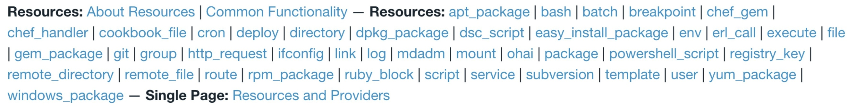
What resource should we use?
http://docs.getchef.com/

Slide 72
What resource should we use?
http://docs.getchef.com/

Slide 73
What resource should we use?
http://docs.getchef.com/

Slide 74
What resource should we use?
http://docs.getchef.com/

Slide 75
What resource should we use?
http://docs.getchef.com/

Slide 76
File Resource
Use the file resource to manage files that are present on a node, including setting or updating the contents of those files.

Slide 77
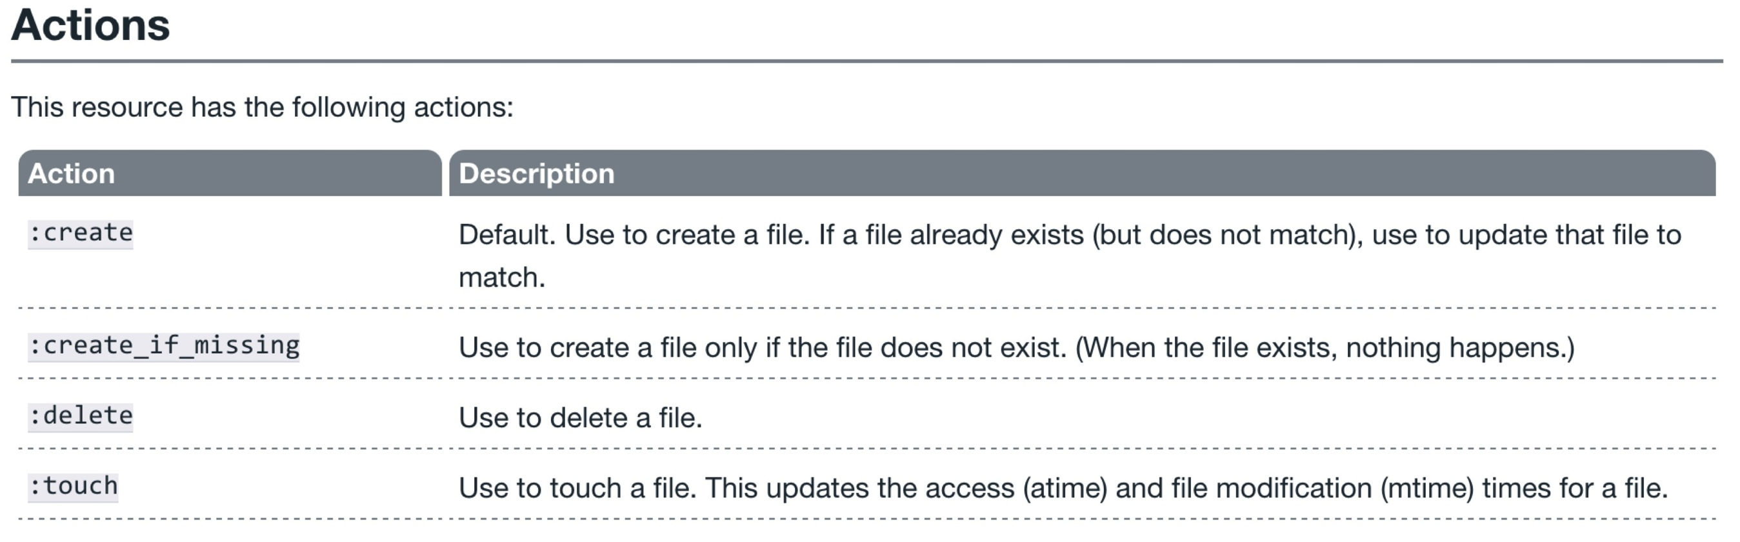
File Resource - Actions
http://docs.getchef.com/resource_file.html#actions

Slide 78
File Resource – content attribute
http://docs.getchef.com/resource_file.html#actions

Slide 79
Write a recipe for apache
~/learnchef/apache.rb
package "httpd"
service "httpd" do
action :start
end
file "/var/www/html/index.html" do
content "<h1>hello world</h1>\n"
end

Slide 80
Re-apply the recipe
sudo chef-apply apache.rb
Recipe: (chef-apply cookbook)::(chef-apply recipe)
* package[httpd] action install (up to date)
* service[httpd] action start (up to date)
* file[/var/www/html/index.html] action create
- update content in file /var/www/html/index.html from 372e08 to 43191a
--- /var/www/html/index.html 2014-09-23 06:05:01.239625369 +0000
+++ /tmp/.index.html20140923-13241-pizl64 2014-09-23 06:06:39.971626393 +0000
@@ -1,2 +1,2 @@
+<h1>Hello, world!</h1>
- restore selinux security context
Notes:
NOTE: this is not the real output. Update it

Slide 81
Is it working?
curl http://localhost
<h1>hello world</h1>

Slide 82
Scenario testing
System administrator logs in to the server and changes the file manually.

Slide 83
Change the home page
/var/www/html/index.html
<h1>Hello, You!</h1>
Notes:
You probably need to use sudo here

Slide 84
Is it working?
curl http://localhost
<h1>Hello, You!</h1>

Slide 85
Re-apply the recipe
sudo chef-apply apache.rb
Recipe: (chef-apply cookbook)::(chef-apply recipe)
* package[httpd] action install (up to date)
* service[httpd] action start (up to date)
* file[/var/www/html/index.html] action create
- update content in file /var/www/html/index.html from 372e08 to 43191a
--- /var/www/html/index.html 2014-09-23 06:05:01.239625369 +0000
+++ /tmp/.index.html20140923-13241-pizl64 2014-09-23 06:06:39.971626393 +0000
@@ -1,2 +1,2 @@
-<h1>Hello, You!</h1>
+<h1>Hello, world!</h1>
- restore selinux security context

Slide 86
Key Learning
Do not manually change files that are being managed by Chef
Changes always start in the code repository

Slide 87
Separating data from policy
Storing the home page content directly in the recipe feels wrong
We can manage that content separately using a different resource
cookbook_file
remote_file
template

Slide 88
Template resource
An ERB template that is used to generate files based on the variables and logic contained within the template.

Slide 89
Problem!
chef-apply is not capable of loading templates
Templates do not belong in the recipe file
It’s time to graduate to chef-client and a cookbook

Slide 90
Cookbooks
Recipes and supporting files

Slide 91
Cookbooks
A cookbook is like a “package” for Chef configuration and policy
Every cookbook will have a name & version
A cookbook can contain
Recipes
Files & Templates
Data attributes
Libraries
And more…

Slide 92
Cookbooks
Typically map 1:1 to a piece of software or functionality.
For example
mysql
users
sercurity
apache
ntp

Slide 93
Infrastructure as Code
Package code into distributable units
Version the code and the packages
Separate data and policy
The web server should have a home page
The home page should have specific content

Slide 94
Lab 3 – Manage the homepage content separately
Problem: Storing the home page content in the recipe is unmanageable
Success Criteria: The home page is stored in it’s own file

Slide 95
chef-repo
Managing infrastructure as code means storing that code in a version control system
Any version control system will do but…
Chef community prefers and recommends git
Many tools support git by default

Slide 96
How many git repos?
Once you have more than one cookbook, you may ask yourself this question
The answer is easy:

Slide 97
How many git repos?
Once you have more than one cookbook, you may ask yourself this questions
The answer is easy:
It depends!

Slide 98
How many git repos?
Once you have more than one cookbook, you may ask yourself this questions
The answer is easy:
It depends!
Two options are common:
Monolithic Repository
Independent Software Projects
Notes:
https://github.com/opscode/chef-rfc/blob/master/rfc019-chef-workflows.md

Slide 99
Monolithic Repository
All of your Chef related source code tracked in one source code repository
External dependencies are made with built-in vendor branches
Notes:
https://github.com/opscode/chef-rfc/blob/master/rfc019-chef-workflows.md#monolithic-repository-workflow

Slide 100
Independent Software Projects
All Chef cookbooks are treated as independent software projects
External dependencies are
fetched as needed
treated as artifacts
Notes:
https://github.com/opscode/chef-rfc/blob/master/rfc019-chef-workflows.md#independent-software-projects-workflow

Slide 101
chef
chef is an executable command line tool for
generating cookbooks, recipes, and other things that make up your Chef code
ensuring RubyGems are downloaded properly for your development environment
verifying that all the components are installed and configured correctly
Included with ChefDK
Notes:
https://docs.getchef.com/ctl_chef.html

Slide 102
Lab 3 – Manage the homepage content separately
Problem: Storing the home page content in the recipe is unmanageable
Success Criteria: The home page is stored in it’s own file

Slide 103
Lab 3 – Manage the homepage content separately
Install git?
Create a chef-repo
Create an apache cookbook

Slide 104
What can chef generate?
chef generate --help
Usage: chef generate GENERATOR [options]
Available generators:
app Generate an application repo
cookbook Generate a single cookbook
recipe Generate a new recipe
attribute Generate an attributes file
template Generate a file template
file Generate a cookbook file
lwrp Generate a lightweight resource/provider
repo Generate a Chef policy repository

Slide 105
How do we generate a repo?
chef generate repo --help
Usage: chef generate repo NAME [options]
-C, --copyright COPYRIGHT Name of the copyright holder - defaults to 'The Authors'
-m, --email EMAIL Email address of the author - defaults to 'you@example.com'
-I, --license LICENSE all_rights, apache2, mit, gplv2, gplv3 - defaults to all_rights
-p, --policy-only Create a repository for policy only, not cookbooks
-g GENERATOR_COOKBOOK_PATH, Use GENERATOR_COOKBOOK_PATH for the code_generator cookbook
--generator-cookbook

Slide 106
A few questions…
Will you store this repo in git?
How can you install git?
Which style of repo will you use?
Monolithic repository?
Independent software projects?

Slide 107
Create a directory
mkdir –p ~/learnchef/lab3

Slide 108
Install git
~/learnchef/lab3/git.rb

Slide 109
Install git
~/learnchef/lab3/git.rb
package 'git’

Slide 110
Install git
~/learnchef/lab3/git.rb
package 'git'
file '/home/chef/.gitconfig' do
content "[user]\n name=John Doe\n email=jdoe@example\n"
user 'chef'
group 'chef'
end

Slide 111
Install git
sudo chef-apply ~/learnchef/lab3/git.rb
Recipe: (chef-apply cookbook)::(chef-apply recipe)
* package[git] action install
- install version 1.7.1-3.el6_4.1 of package git
* file[/home/chef/.gitconfig] action create
- create new file /home/chef/.gitconfig
- update content in file /home/chef/.gitconfig from none to 259950
--- /home/chef/.gitconfig 2014-09-24 00:24:13.558127555 +0000
+++ /tmp/..gitconfig20140924-10180-1ij68vq 2014-09-24 00:24:13.559127555 +0000
@@ -1 +1,4 @@
+[user]
+ name=John Doe
+ email=jdoe@example.com
- change owner from '' to 'chef'
- change group from '' to 'chef'
- restore selinux security context

Slide 112
Lab 3 – Manage the homepage content separately
Install git?
Create a chef-repo
Create an apache cookbook

Slide 113
Go home!
cd ~

Slide 114
Create a chef-repo
chef generate repo chef-repo -p
Compiling Cookbooks...
Recipe: code_generator::repo
* directory[/home/chef/chef-repo] action create
- create new directory /home/chef/chef-repo
- restore selinux security context
* template[/home/chef/chef-repo/LICENSE] action create
- create new file /home/chef/chef-repo/LICENSE
- update content in file /home/chef/chef-repo/LICENSE from none to dbc1af
(diff output suppressed by config)
- restore selinux security context
* cookbook_file[/home/chef/chef-repo/README.md] action create
- create new file /home/chef/chef-repo/README.md
- update content in file /home/chef/chef-repo/README.md from none to 767ead
(diff output suppressed by config)
- restore selinux security context
* cookbook_file[/home/chef/chef-repo/Rakefile] action create
Notes:
-p creates a policy only repository
Policy only repo includes the following in the .gitignore
cookbooks/**
!cookbooks/README.md
So the cookbooks directory will be ignored.

Slide 115
Commit this chef-repo to git
cd chef-repo

Slide 116
git init
Initialized empty Git repository in /home/chef/chef-repo/.git/

Slide 117
Commit this chef-repo to git
git add .

Slide 118
Commit this chef-repo to git
git commit -m "Initial chef-repo"
[master (root-commit) 6774a70] Initial chef repo
11 files changed, 388 insertions(+), 0 deletions(-)
create mode 100644 .gitignore
create mode 100644 LICENSE
create mode 100644 README.md
create mode 100644 Rakefile
create mode 100644 certificates/README.md
create mode 100644 chefignore
create mode 100644 config/rake.rb
create mode 100644 cookbooks/README.md
create mode 100644 data_bags/README.md
create mode 100644 environments/README.md
create mode 100644 roles/README.md

Slide 119
Lab 3 – Manage the homepage content separately
Install git?
Create a chef-repo
Create an apache cookbook

Slide 120
Create an apache cookbook
chef generate cookbook --help
Usage: chef generate cookbook NAME [options]
-C, --copyright COPYRIGHT Name of the copyright holder - defaults to 'The Authors'
-m, --email EMAIL Email address of the author - defaults to 'you@example.com'
-I, --license LICENSE all_rights, apache2, mit, gplv2, gplv3 - defaults to all_rights
-g GENERATOR_COOKBOOK_PATH, Use GENERATOR_COOKBOOK_PATH for the code_generator cookbook
--generator-cookbook

Slide 121
Create an apache cookbook
cd cookbooks

Slide 122
Create an apache cookbook
chef generate cookbook apache
Compiling Cookbooks...
Recipe: code_generator::cookbook
* directory[/home/chef/chef-repo/cookbooks/apache] action create
- create new directory /home/chef/chef-repo/cookbooks/apache
- restore selinux security context
* template[/home/chef/chef-repo/cookbooks/apache/metadata.rb] action create_if_missing
- create new file /home/chef/chef-repo/cookbooks/apache/metadata.rb
- update content in file /home/chef/chef-repo/cookbooks/apache/metadata.rb from none to 94785f
(diff output suppressed by config)
- restore selinux security context
* template[/home/chef/chef-repo/cookbooks/apache/README.md] action create_if_missing
- create new file /home/chef/chef-repo/cookbooks/apache/README.md
- update content in file /home/chef/chef-repo/cookbooks/apache/README.md from none to 5c3d3a
(diff output suppressed by config)
- restore selinux security context
* cookbook_file[/home/chef/chef-repo/cookbooks/apache/chefignore] action create
- create new file /home/chef/chef-repo/cookbooks/apache/chefignore
- update content in file /home/chef/chef-repo/cookbooks/apache/chefignore from none to 9727b1
(diff output suppressed by config)
- restore selinux security context
* cookbook_file[/home/chef/chef-repo/cookbooks/apache/Berksfile] action create_if_missing

Slide 123
Create new git repo for this cookbook
cd apache

Slide 124
Create new git repo for this cookbook
git init
Initialized empty Git repository in /home/chef/chef-repo/cookbooks/apache/.git/

Slide 125
Commit the initial cookbook
git add .

Slide 126
Commit the initial cookbook
git commit -m "initial apache recipe, does nothing"
[master (root-commit) af2b629] initial apache recipe, does nothing
6 files changed, 144 insertions(+), 0 deletions(-)
create mode 100644 .kitchen.yml
create mode 100644 Berksfile
create mode 100644 README.md
create mode 100644 chefignore
create mode 100644 metadata.rb
create mode 100644 recipes/default.rb

Slide 127
Write the default recipe
chef-repo/cookbooks/apache/recipes/default.rb
#
# Cookbook Name:: apache
# Recipe:: default
#
# Copyright (c) 2014 The Authors, All Rights Reserved.
package "httpd"
service "httpd" do
action :start
end
file "/var/www/html/index.html" do
content "<h1>hello world</h1>\n"
end
Notes:
Can also copy from lab2
cp ~/learnchef/lab2/apache.rb ~/chef-repo/cookbooks/apache/default.rb

Slide 128
Wait a tick!
We wanted to move the contents of the home page to another file
Let’s change the file resource to a template resource

Slide 129
Replace the file resource
chef-repo/cookbooks/apache/recipes/default.rb
...
template "/var/www/html/index.html" do
source "index.html.erb"
end
Notes:
Can also copy from lab2
cp ~/learnchef/lab2/apache.rb ~/chef-repo/cookbooks/apache/default.rb

Slide 130
Template resource
An ERB template that is used to generate files based on the variables and logic contained within the template.

Slide 131
Create a new template file
Template files are ERB files
The chef command includes a template generator

Slide 132
Let’s create a template!
chef generate template --help
Usage: chef generate template [path/to/cookbook] NAME [options]
-C, --copyright COPYRIGHT Name of the copyright holder - defaults to 'The Authors'
-m, --email EMAIL Email address of the author - defaults to 'you@example.com'
-I, --license LICENSE all_rights, apache2, mit, gplv2, gplv3 - defaults to all_rights
-s, --source SOURCE_FILE Copy content from SOURCE_FILE
-g GENERATOR_COOKBOOK_PATH, Use GENERATOR_COOKBOOK_PATH for the code_generator cookbook
--generator-cookbook

Slide 133
Go to the chef-repo
cd ~/chef-repo

Slide 134
Let’s create a template!
chef generate template cookbooks/apache/ index.html -s /var/www/html/index.html
Compiling Cookbooks...
Recipe: code_generator::template
* directory[cookbooks/apache/templates/default] action create
- create new directory cookbooks/apache/templates/default
- restore selinux security context
* file[cookbooks/apache/templates/default/index.html.erb] action create
- create new file cookbooks/apache/templates/default/index.html.erb
- update content in file cookbooks/apache/templates/default/index.html.erb from none to cdf94d
(diff output suppressed by config)
- restore selinux security context
Notes:
chef generate template [path/to/cookbook] NAME [options]
-s source file, copy the contents from this file into the template

Slide 135
Check the template
cat cookbooks/apache/templates/default/index.html.erb
<h1>hello world</h1>

Slide 136
Lab 3 – Manage the homepage content separately
Install git?
Create a chef-repo
Create an apache cookbook

Slide 137
Verify the changes
sudo chef-client -z -r "recipe[apache]"
[2014-09-17T11:21:52+00:00] WARN: No config file found or specified on command line, using command line options.
Starting Chef Client, version 11.16.0
resolving cookbooks for run list: ["apache"]
Synchronizing Cookbooks:
- apache
Compiling Cookbooks...
Converging 3 resources
Recipe: apache::default
* package[httpd] action install (up to date)
* service[httpd] action start (up to date)
* template[/var/www/html/index.html] action create (up to date)
Running handlers:
Running handlers complete
Chef Client finished, 0/3 resources updated in 5.637631958 seconds

Slide 138
Verify the changes
curl http://localhost
<h1>hello world</h1>

Slide 139
Ensuring desired state
chef-client and run lists

Slide 140
chef-client
chef-client is an executable
performs all actions required to bring the node into the desired state
typically run on a regular basis
daemon
cron
Windows service
Included with ChefDK

Slide 141
chef-client modes
In conjunction with a Chef Server
Local mode (no Chef Server)
Typically run with elevated privileges
root, sudo, or Administrator
Can run as non-root user

Slide 142
chef-client privileges
Usually run with elevated privileges
root
sudo
Administrator
Can run as a normal user

Slide 143
Desired State
Policies describe the desired state
Each node can follow a sub-set of policies
The policies for each node are stored in a run list

Slide 144


Run List
ntp cookbook
users cookbook
mysql cookbook

Slide 145
Run List
recipe[ntp::client]
recipe[users]
ntp cookbook
users cookbook
mysql cookbook

Slide 146
Run List
recipe[ntp::client]
recipe[users]
ntp cookbook
recipe[ntp::client]
recipe[users]
recipe[mysql::client]
users cookbook
mysql cookbook

Slide 147
Run List
recipe[ntp::client]
recipe[users]
ntp cookbook
recipe[ntp::client]
recipe[users]
recipe[mysql::client]
users cookbook
recipe[ntp::client]
recipe[users]
recipe[mysql::server]
mysql cookbook

Slide 148
Run List
recipe[ntp::client]
recipe[users]
ntp cookbook
recipe[ntp::client]
recipe[users]
recipe[mysql::client]
users cookbook
recipe[ntp::client]
recipe[users]
recipe[mysql::server]
mysql cookbook

Slide 149
Lab 4 – Verify the cookbook
Problem: We need to test our new apache cookbook
Success Criteria: The default recipe applies cleanly and our home page is visible

Slide 150
Run chef-client with a run list
sudo chef-client -z -r "recipe[apache]"
Starting Chef Client, version 11.16.0
resolving cookbooks for run list: ["apache"]
Synchronizing Cookbooks:
- apache
Compiling Cookbooks...
Converging 3 resources
Recipe: apache::default
* package[httpd] action install (up to date)
* service[httpd] action start (up to date)
* file[/var/www/html/index.html] action create (up to date)
Running handlers:
Running handlers complete
Chef Client finished, 0/3 resources updated in 14.375566874 seconds

Slide 151
Verify the home page
curl http://localhost
<h1>hello world</h1>

Slide 152
Infrastructure State
The node object

Slide 153

Node Object
A node is a physical, virtual, or cloud machine that is managed by the chef-client
Node object is a data structure representing the state of a node
https://docs.getchef.com/chef_overview_nodes.html

Slide 154
Node state
chef-client saves the current state of the node
Local mode – in the nodes directory
Normal mode – on the Chef server

Slide 155
New directory: nodes
ls ~/chef-repo/nodes
ip-172-31-32-114.ec2.internal.json
Notes:
~/chef-repo/nodes

Slide 156
Explore the node’s .json file
less nodes/*.json
{
"name": "ip-172-31-32-114.ec2.internal",
"normal": {
"tags": [
]
},
"automatic": {
"languages": {
"ruby": {
"platform": "x86_64-linux",
"version": "2.1.2",
"release_date": "2014-05-08",
"target": "x86_64-unknown-linux-gnu",
"target_cpu": "x86_64",
"target_vendor": "unknown",
"target_os": "linux",
"host": "x86_64-unknown-linux-gnu",
"host_cpu": "x86_64",
"host_os": "linux-gnu",
…
Notes:
wc ~/chef-repo/nodes/ip-172-31-41-194.ec2.internal.json

Slide 157
ohai
A system profiler that is used to detect the state of nodes
Platform
Network
Memory
And much more
Included with ChefDK

Slide 158
Run ohai
ohai | less
{
"languages": {
"ruby": {
"platform": "x86_64-linux",
"version": "2.1.2",
"release_date": "2014-05-08",
"target": "x86_64-unknown-linux-gnu",
"target_cpu": "x86_64",
"target_vendor": "unknown",
"target_os": "linux",
"host": "x86_64-unknown-linux-gnu",
"host_cpu": "x86_64",
"host_os": "linux-gnu",
"host_vendor": "unknown",
"bin_dir": "/opt/chefdk/embedded/bin",
"ruby_bin": "/opt/chefdk/embedded/bin/ruby",
"gems_dir": "/opt/chefdk/embedded/lib/ruby/gems/2.1.0",
"gem_bin": "/opt/chefdk/embedded/bin/gem"
},
…

Slide 159
Use ohai to find the platform
ohai platform
[
"centos"
]

Slide 160
Find the platform in the node object
grep '"platform"' nodes/*.json
"platform": "x86_64-linux",
"platform": "centos",

Slide 161
Lab 5 – Read node attributes in our policy
Problem: We want to see some node details on our home page.
Success Criteria: Our home page includes additional information about the node

Slide 162
Display node attributes
cookbooks/apache/templates/default/index.html.erb
<h1>hello world</h1>
<p>
This is a <%= node["platform"] %> <%= node["platform_version"] %> server.
with <%= node["memory"]["total"] %> RAM.
</p>

Slide 163
Display node attributes
cookbooks/apache/templates/default/index.html.erb
<h1>hello world</h1>
<p>
This is a <%= node["platform"] %> <%= node["platform_version"] %> server.
with <%= node["memory"]["total"] %> RAM.
</p>

Slide 164
Display node attributes
cookbooks/apache/templates/default/index.html.erb
<h1>hello world</h1>
<p>
This is a <%= node["platform"] %> <%= node["platform_version"] %> server.
with <%= node["memory"]["total"] %> RAM.
</p>

Slide 165
Display node attributes
cookbooks/apache/templates/default/index.html.erb
<h1>hello world</h1>
<p>
This is a <%= node["platform"] %> <%= node["platform_version"] %> server.
with <%= node["memory"]["total"] %> RAM.
</p>

Slide 166
Display node attributes
cookbooks/apache/templates/default/index.html.erb
<h1>hello world</h1>
<p>
This is a <%= node["platform"] %> <%= node["platform_version"] %> server.
with <%= node["memory"]["total"] %> RAM.
</p>

Slide 167
Verify the change
sudo chef-client -z -r "recipe[apache]"
Starting Chef Client, version 11.16.0
resolving cookbooks for run list: ["apache"]
Synchronizing Cookbooks:
- apache
Compiling Cookbooks...
Converging 3 resources
Recipe: apache::default
* package[httpd] action install (up to date)
* service[httpd] action start (up to date)
* template[/var/www/html/index.html] action create
- update content in file /var/www/html/index.html from cdf94d to 4ff592
--- /var/www/html/index.html 2014-09-23 13:28:23.912127556 +0000
+++ /tmp/chef-rendered-template20140924-11927-m0wkgp 2014-09-24 02:07:43.954127556 +0000
@@ -1,2 +1,8 @@
<h1>hello world</h1>
+
+<p>
+ This is a centos 6.5 server.
+ with 1695028kB RAM.
+</p>
+
- restore selinux security context
Running handlers:
Running handlers complete
Chef Client finished, 1/3 resources updated in 14.101936386 seconds

Slide 168
Verify the change
curl http://localhost
<h1>hello world</h1>
<p>
This is a centos 6.5 server.
with 1695028kB RAM.
</p>
Notes:
Might want / need to clarify node object vs. ohai
node object’s state is updated by chef-client
grep uptime nodes/*.json; ohai uptime; sleep 60; grep uptime nodes/*.json; ohai uptime
"uptime_seconds": 47716,
"uptime": "13 hours 15 minutes 16 seconds",
[
"13 hours 17 minutes 54 seconds"
]
"uptime_seconds": 47716,
"uptime": "13 hours 15 minutes 16 seconds",
[
"13 hours 18 minutes 55 seconds"
]

Slide 169
Custom node attributes
Ohai provides many attributes for the node object
You may want to include your own custom attributes

Slide 170
Lab 6 - Create a custom node attribute
Problem: We need a customized greeting on our home page.
Success Criteria: Our home page includes a custom greeting.

Slide 171
Lab 6 - Create a custom node attribute
Create the attribute
Display the attribute on the home page

Slide 172
chef can generate attributes
chef generate attribute --help
Usage: chef generate attribute [path/to/cookbook] NAME [options]
-C, --copyright COPYRIGHT Name of the copyright holder - defaults to 'The Authors'
-m, --email EMAIL Email address of the author - defaults to 'you@example.com'
-I, --license LICENSE all_rights, apache2, mit, gplv2, gplv3 - defaults to all_rights
-g GENERATOR_COOKBOOK_PATH, Use GENERATOR_COOKBOOK_PATH for the code_generator cookbook
--generator-cookbook

Slide 173
Generate attribute
chef generate attribute cookbooks/apache/ default
Compiling Cookbooks...
Recipe: code_generator::attribute
* directory[cookbooks/apache/attributes] action create
- create new directory cookbooks/apache/attributes
- restore selinux security context
* template[cookbooks/apache/attributes/default.rb] action create
- create new file cookbooks/apache/attributes/default.rb
- update content in file cookbooks/apache/attributes/default.rb from none to e3b0c4
(diff output suppressed by config)
- restore selinux security context

Slide 174
Create an attribute
cookbooks/apache/attributes/default.rb
default['apache']['greeting'] = "DC"
Notes:
Good practice to name space your attributes within the cookbook

Slide 175
Update the home page
cookbooks/apache/templates/default/index.html.erb
<h1>hello <%= node["apache"]["greeting"] %></h1>
<p>
This is a <%= node["platform"] %> <%= node["platform_version"] %> server.
with <%= node["memory"]["total"] %> RAM.
</p>

Slide 176
Verify the change
sudo chef-client -z -r "recipe[apache]"
Starting Chef Client, version 11.16.0
resolving cookbooks for run list: ["apache"]
Synchronizing Cookbooks:
- apache
Compiling Cookbooks...
Converging 3 resources
Recipe: apache::default
* package[httpd] action install (up to date)
* service[httpd] action start (up to date)
* template[/var/www/html/index.html] action create
- update content in file /var/www/html/index.html from 4ff592 to 470462
--- /var/www/html/index.html 2014-09-24 02:07:43.954127556 +0000
+++ /tmp/chef-rendered-template20140924-12185-11ypb0t 2014-09-24 02:25:25.833127556 +0000
@@ -1,4 +1,4 @@
-<h1>hello world</h1>
+<h1>hello DC</h1>
<p>
This is a centos 6.5 server.
- restore selinux security context
Running handlers:
Running handlers complete
Chef Client finished, 1/3 resources updated in 14.061031604 seconds

Slide 177
Verify the change
curl http://localhost
<h1>hello DC</h1>
<p>
This is a centos 6.5 server.
with 1695028kB RAM.
</p>
Notes:
Might want / need to clarify node object vs. ohai
node object’s state is updated by chef-client
grep uptime nodes/*.json; ohai uptime; sleep 60; grep uptime nodes/*.json; ohai uptime
"uptime_seconds": 47716,
"uptime": "13 hours 15 minutes 16 seconds",
[
"13 hours 17 minutes 54 seconds"
]
"uptime_seconds": 47716,
"uptime": "13 hours 15 minutes 16 seconds",
[
"13 hours 18 minutes 55 seconds"
]

Slide 178
Faster Feedback
Automate your testing

Slide 179
Our process
Write policy
Apply policy
Verify policy
Not bad for the simple case, will quickly get untenable

Slide 180
Faster Feedback
Speed-up the feedback loops with automated testing.
Have confidence in your changes before you run them in production

Slide 181
The pedantries of testing
Unit testing
Integration testing
Acceptance testing
Functional testing
Regression testing
Smoke testing
Load testing
Notes:
I don’t want to get bogged down in the various types of testing. It’s not something that’s going to help us today.

Slide 182
Chef Testing
Did chef-client complete successfully?
Did the recipe put the node in the desired state?
Are the resources properly defined?
Does the code following our style guide?

Slide 183
Chef client success status
Requirements to verify chef-client success:
A place to store the cookbook artifact

Slide 184
Chef client success status
Requirements to verify chef-client success:
A place to store the cookbook artifact
A chef-client with access to the cookbook

Slide 185
Chef client success status
Requirements to verify chef-client success:
A place to store the cookbook artifact
A chef-client with access to the cookbook
A target server running the same OS as production

Slide 186

Test Kitchen
Test harness to execute code on one or more platforms
Driver plugins to allow your code to run on various cloud and virtualization providers
Includes support for many testing frameworks
Included with ChefDK

Slide 187
.kitchen.yml
The configuration file for your Test Kitchen
driver – virtualization or cloud provider
provisioner – application to configure the node
platforms – target operating systems
suites – target configurations

Slide 188
Update .kitchen.yml
cookbooks/apache/.kitchen.yml
---
driver:
name: docker
provisioner:
name: chef_zero
platforms:
- name: centos-6.4
suites:
- name: default
run_list:
- recipe[apache::default]
attributes:

Slide 189

Docker
Portable, lightweight application runtime
Linux containers
Installed on the workstation
https://d3oypxn00j2a10.cloudfront.net/0.10.3/img/homepage/docker-whale-home-logo-@2x.png?cf34b4b2b839

Slide 190
Verify docker
sudo docker images
REPOSITORY TAG IMAGE ID CREATED VIRTUAL SIZE
centos centos5 5a1ebaa356ff 2 weeks ago 484 MB
centos centos7 70214e5d0a90 2 weeks ago 224 MB
centos latest 70214e5d0a90 2 weeks ago 224 MB
centos centos6 68eb857ffb51 2 weeks ago 212.7 MB
Notes:
The images were installed using: sudo docker pull cetos

Slide 191
kitchen-docker gem
A driver that allows Test Kitchen to work with Docker
Installed on the workstation
ChefDK includes kitchen-vagrant

Slide 192
Verify kitchen-docker is installed
gem list kitchen
*** LOCAL GEMS ***
kitchen-docker (1.5.0)
kitchen-vagrant (0.15.0)
test-kitchen (1.2.1)

Slide 193
Lab 7 – Verify chef-client success
Problem: Testing our cookbook takes too long
Success Criteria: Our cookbook runs in test kitchen

Slide 194
Move to the apache cookbook directory
cd ~/chef-repo/cookbooks/apache

Slide 195
List the Test Kitchens
kitchen list
Instance Driver Provisioner Last Action
default-centos-64 Docker ChefZero <Not Created>

Slide 196
Create the kitchen
kitchen create
-----> Starting Kitchen (v1.2.1)
-----> Creating <default-centos-64>...
Step 0 : FROM centos:centos6
---> 68eb857ffb51
Step 1 : RUN yum clean all
---> Running in cdf3952a3f18
Loaded plugins: fastestmirror
Cleaning repos: base extras libselinux updates
Cleaning up Everything
---> b1cccd25ce55
Removing intermediate container cdf3952a3f18
Step 2 : RUN yum install -y sudo openssh-server openssh-clients which curl
---> Running in 9db69ace459d
Loaded plugins: fastestmirror

Slide 197
Converge: run chef in the kitchen
kitchen converge
-----> Starting Kitchen (v1.2.1)
-----> Converging <default-centos-64>...
Preparing files for transfer
Resolving cookbook dependencies with Berkshelf 3.1.5...
Removing non-cookbook files before transfer
-----> Installing Chef Omnibus (true)
downloading https://www.getchef.com/chef/install.sh
to file /tmp/install.sh
trying curl...

Slide 198
Break the cookbook
recipes/default.rb
package "apache"
service "httpd" do
action :start
end
template "/var/www/html/index.html" do
source "index.html.erb"
end

Slide 199
Re-converge
kitchen converge
…
Chef Client failed. 0 resources updated in 41.075753164 seconds
[2014-09-24T04:29:31+01:00] ERROR: package[apache] (apache::default line 6) had an error: Chef::Exceptions::Package: No version specified, and no candidate version available for apache
[2014-09-24T04:29:31+01:00] FATAL: Chef::Exceptions::ChildConvergeError: Chef run process exited unsuccessfully (exit code 1)
>>>>>> Converge failed on instance <default-centos-64>.
>>>>>> Please see .kitchen/logs/default-centos-64.log for more details
>>>>>> ------Exception-------
>>>>>> Class: Kitchen::ActionFailed
>>>>>> Message: SSH exited (1) for command: [sudo -E chef-client -z --config /tmp/kitchen/client.rb --log_level info --json-attributes /tmp/kitchen/dna.json]
>>>>>> ----------------------

Slide 200
Fix the cookbook
recipes/default.rb
package "httpd"
service "httpd" do
action :start
end
template "/var/www/html/index.html" do
source "index.html.erb"
end

Slide 201
Converge: run chef in the kitchen
kitchen converge
[2014-09-24T04:30:45+01:00] INFO: Chef Run complete in 4.110425475 seconds
Running handlers:
[2014-09-24T04:30:45+01:00] INFO: Running report handlers
Running handlers complete
[2014-09-24T04:30:45+01:00] INFO: Report handlers complete
Chef Client finished, 0/3 resources updated in 11.323451399 seconds
Finished converging <default-centos-64> (0m18.84s).
-----> Kitchen is finished. (0m20.09s)

Slide 202
Chef Testing
Did chef-client complete successfully?
Did the recipe put the node in the desired state?
Are the resources properly defined?
Does the code following our style guide?

Slide 203
Lab 8 – Verify the node
Problem: Successful converge does not necessarily mean the node is in the desired state.
Success Criteria: Verify our home page is being served.

Slide 204
Manually Inspect with kitchen login
kitchen login
kitchen@localhost's password:

Slide 205
Manually Inspect with kitchen login
kitchen login
kitchen@localhost's password:
kitchen

Slide 206
Manually Inspect with kitchen login
kitchen login
kitchen@localhost's password:
Last login: Wed Sep 24 04:30:29 2014 from 172.17.42.1
kitchen

Slide 207
Manually Inspect with kitchen login
curl http://localhost
<h1>hello DC</h1>
<p>
This is a centos 6.5 server.
with 1695028kB RAM.
</p>

Slide 208

Serverspec
Write RSpec tests to verify your servers
Not dependent on Chef
Defines many resource types
package, service, user, etc.
Works well with Test Kitchen
http://serverspec.org/

Slide 209
Create directory for serverspec tests
mkdir -p test/integration/default/serverspec

Slide 210
Write a Serverspec test
test/integration/default/serverspec/default_spec.rb
require 'serverspec'
set :backend, :exec
describe 'apache' do
it "is installed" do
expect(package 'httpd').to be_installed
end
end

Slide 211
Destroy the existing kitchen
kitchen destroy
-----> Starting Kitchen (v1.2.1)
-----> Destroying <default-centos-64>...
[{
"Args": [
"-D",
"-o",
"UseDNS=no",
"-o",
"UsePAM=no",
"-o",
"UsePrivilegeSeparation=no",
"-o",

Slide 212
Verify the kitchen
kitchen verify
-----> Setting up Busser
Creating BUSSER_ROOT in /tmp/busser
Creating busser binstub
Plugin serverspec installed (version 0.2.6)
-----> Running postinstall for serverspec plugin
Finished setting up <default-centos-64> (0m32.59s).
-----> Verifying <default-centos-64>...
Suite path directory /tmp/busser/suites does not exist, skipping.
Uploading /tmp/busser/suites/serverspec/default_spec.rb (mode=0664)
-----> Running serverspec test suite
/opt/chef/embedded/bin/ruby -I/tmp/busser/suites/serverspec -S /opt/chef/embedded/bin/rspec /tmp/busser/suites/serverspec/default_spec.rb --color --format documentation
apache
is installed
Finished in 0.29547 seconds
1 example, 0 failures
Finished verifying <default-centos-64> (0m4.44s).
-----> Kitchen is finished. (1m25.74s)

Slide 213
Extend the Serverspec test
test/integration/default/serverspec/default_spec.rb
describe 'apache' do
it "is installed" do
expect(package 'httpd').to be_installed
end
it "is running" do
expect(service 'httpd').to be_running
end
it "is listening on port 80" do
expect(port 80).to be_listening
end
it "displays a custom home page" do
expect(command("curl localhost").stdout).to match /hello/
end
end

Slide 214
Verify the kitchen
kitchen verify
apache
is installed
is running
is listening on port 80
displays a custom home page
Finished in 0.3968 seconds
4 examples, 0 failures
Finished verifying <default-centos-64> (0m4.25s).

Slide 215
Change the test
test/integration/default/serverspec/default_spec.rb
describe 'apache' do
it "is installed" do
expect(package 'httpd').to be_installed
end
it "is running" do
expect(service 'httpd').to be_running
end
it "is listening on port 80" do
expect(port 80).to be_listening
end
it "displays a custom home page" do
expect(command("curl localhost").stdout).to match /hello/
end
end

Slide 216
Verify the kitchen
kitchen verify
apache
is installed
is running
is listening on port 80 (FAILED - 1)
displays a custom home page
Failures:
1) apache is listening on port 80
On host ``
Failure/Error: expect(port 81).to be_listening
netstat -tunl | grep -- :81\
expected Port "81" to be listening
# /tmp/busser/suites/serverspec/default_spec.rb:16:in `block (2 levels) in <top (required)>'
Finished in 0.38488 seconds
4 examples, 1 failure

Slide 217
Reset the Serverspec test
test/integration/default/serverspec/default_spec.rb
describe 'apache' do
it "is installed" do
expect(package 'httpd').to be_installed
end
it "is running" do
expect(service 'httpd').to be_running
end
it "is listening on port 80" do
expect(port 80).to be_listening
end
it "displays a custom home page" do
expect(command("curl localhost").stdout).to match /hello/
end
end

Slide 218
Kitchen Workflow
kitchen create
kitchen converge
kitchen verify
kitchen destroy
All at once with kitchen test

Slide 219
Chef Testing
Did chef-client complete successfully?
Did the recipe put the node in the desired state?
Are the resources properly defined?
Does the code following our style guide?

Slide 220
Lab 9 – Verify the resources
Problem: We should be able to catch errors before we need to converge a node
Success Criteria: Catch a typo prior to converge

Slide 221
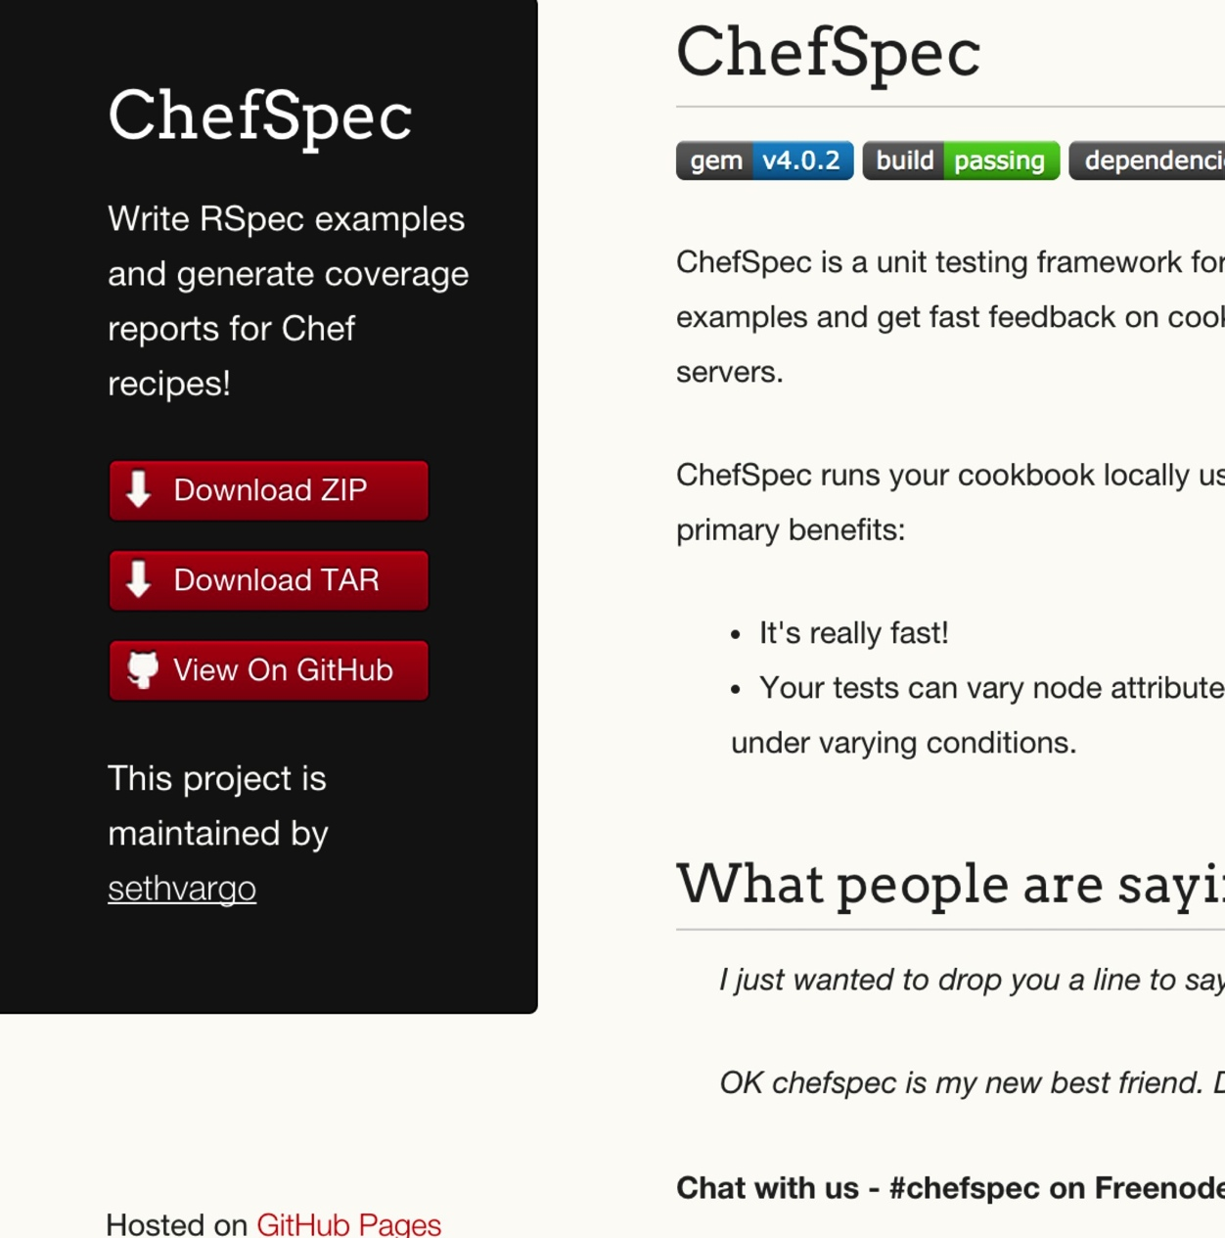
ChefSpec
Test before you converge
Get feedback on cookbook changes without the need for target servers
http://sethvargo.github.io/chefspec/

Slide 222
Make a directory for our ChefSpec tests
mkdir -p spec/unit
Notes:
~/chef-repo/cookbooks/apache/

Slide 223
Write a ChefSpec test
spec/unit/default.rb
require 'chefspec'
describe 'apache::default' do
let(:chef_run) do
ChefSpec::Runner.new.converge(described_recipe)
end
it 'installs apache' do
expect(chef_run).to install_package('httpd')
end
end

Slide 224
Run the ChefSpec tests
rspec spec/unit/*.rb
.
Finished in 0.00865 seconds (files took 5.5 seconds to load)
1 example, 0 failures

Slide 225
Break the cookbook
recipes/default.rb
package "http"
service "httpd" do
action :start
end
template "/var/www/html/index.html" do
source "index.html.erb"
end

Slide 226
Run the ChefSpec tests
rspec spec/unit/*.rb
F
Failures:
1) apache::default installs apache
Failure/Error: expect(chef_run).to install_package('httpd')
expected "package[httpd]" with action :install to be in Chef run. Other package resources:
package[http]
# ./spec/unit/default_spec.rb:9:in `block (2 levels) in <top (required)>'
Finished in 0.00847 seconds (files took 4.85 seconds to load)
1 example, 1 failure
Failed examples:
rspec ./spec/unit/default_spec.rb:8 # apache::default installs apache

Slide 227
Fix the cookbook
recipes/default.rb
package "httpd"
service "httpd" do
action :start
end
template "/var/www/html/index.html" do
source "index.html.erb"
end

Slide 228
Chef Testing
Did chef-client complete successfully?
Did the recipe put the node in the desired state?
Are the resources properly defined?
Does the code following our style guide?

Slide 229

Foodcritic
Check cookbooks for common problems
Style, correctness, deprecations, etc.
Included with ChefDK
http://www.foodcritic.io/

Slide 230
Change our recipe
recipes/default.rb
package_name = "httpd"
package "#{package_name}"
service "httpd" do
action :start
end
template "/var/www/html/index.html" do
source "index.html.erb"
end

Slide 231
Run Foodcritic
foodcritic .
FC002: Avoid string interpolation where not required: ./recipes/default.rb:7

Slide 232
Chef Testing
Did chef-client complete successfully?
Did the recipe put the node in the desired state?
Are the resources properly defined?
Does the code following our style guide?

Slide 233
Wrap Up

Slide 234
Course Objectives
After completing this course you will be able to:
Automate common infrastructure tasks with Chef
Describe Chef’s various tools
Apply Chef’s primitives to solve your problems
Verify your automation code BEFORE it runs in production

Slide 235
Tool Survey
chef-apply
chef
chef-client in local mode
ohai
Test Kitchen
Docker
Serverspec
ChefSpec
Foodcritic

Slide 236
Vocabulary
Resources
Recipes
Cookbooks
Run List
Node
Node Object

Slide 237
Resources
Package
Service
File
Template

Slide 238
Repository Layout
Monolithic Repository
Independent Software Projects

Slide 239
But wait…
…there’s more, so much more!
How much time do we have left? I could go on for days!

Slide 240
Further Resources
learnchef.com
Guided tutorials
Chef Fundamental Series
Upcoming Training
getchef.com/blog/events/category/training-events/

Slide 241
Training in DC
SURGE14 will save 20%
Chef Fundamentals – October 27-28
Chef Intermediate Topics – October 29-30

Slide 242
Chef Fundamentals Q & A Forum
Chef Fundamentals Google Group Q&A Forum
http://bit.ly/ChefFundamentalsForum
Join the group and post questions

Slide 243
A list of URLs
http://getchef.com
http://docs.getchef.com
http://supermarket.getchef.com
http://youtube.com/getchef
http://lists.opscode.com
irc.freenode.net: #chef, #chef-hacking
Twitter: @chef #getchef, @learnchef #learnchef

Slide 244
Food Fight Show
foodfightshow.org
Podcast where DevOps Chefs Do Battle
Best practices for working with Chef

Slide 245

getchef.com/summit

Slide 246
Local Meetup Groups
DevOpsDC
DC Configuration Management Group
Charm City Linux
AWS Washington DC Meetup
LOPSA DC
Amazon Web Services – Virginia
DevOpsCV – Central Virginia (Charlottesville)
DC Continuous Delivery Meetup
Scale DC
Cloud DC
Washington DevOps in Government Meetup
DC Area Enterprise DevOps and Agile Forum

Slide 247
What questions do you have?
Chef Server
Roles
Environments
Data Bags
Bootstrapping new nodes
Thank You!
Open source projects
Working with IaaS providers
chef-metal
Search
Suspenders?!
@nathenharvey

